Slide 1
Evaluatıon of Haır Loss After Covıd-19
Esma Nur Keskin
Mentör: Prof. Dr. Özlem Su Küçük

Slide 3
INTRODUCTION
Human hair grows continuously and cyclically (anagen). The period of development of the hair cycle, cessation of growth (catagen), and resting period constitute.
Hair loss clinical types are Diffuse, Androgenetic alopecia, Telogen effluvium, Focal Alopecia areata, Trichotillomania, Traction alopecia, Tinea capitis and Scarred alopecia.
The causes of hair loss are genetic predisposition, hair growth disorders, systemic diseases and autoimmunity, scalp diseases and drugs.
The new Coronavirus infection has caused a global pandemic all over the world. Due to the psychological and other side effects of the pandemic, there has been an increase in the number of patients visiting dermatology outpatient clinics with hair loss complaints.
We aimed to examine the change profiles of patients with hair loss complaints during the summer months of the COVID-19 pandemic with the same period of the previous year.

Slide 4
METHOD
We included a total of 105 patients who applied to our hospital with hair loss in the summer of 2019 and 2020 in our study.
All patients’ age, gender, presence of prolonged hair loss, comorbidity, medication use and history of surgery are recorded.
We questioned whether our patients had Covid-19 and whether there was an increase in their complaints during the pandemic process.
We evaluated the results of their blood tests such as hemoglobin, ferritin, folic acid, TSH, anti TPO, zinc, biotin, vitamin B12 and vitamin D.
All analysis was performed using IBM SPSS.

Slide 5
RESULTS
67 female (%63.8) and 38 male (%36.2)
Mean age= 30,79
% 42.9 have prolonged hair loss
%29.5 have comorbidity, %26.7 use medication and %30.5 had surgery
18 patients had covid infection and 3 of them had no symptoms.
Treatment
Covid
YES
Covid
+
NO
7
-
18
11
87

Slide 6
During the pandemic, 51 patients' complaints increased, and 12 of them were people with covid infection.
Increase of hair loss complaints in 66.7% of patients who caught covid.
According to Fisher-Freeman-Halton Exact test there is a statistically significant and positively association between Covid-19 infection and hair loss (p=0.001).

Slide 7
There is not any positive correlation between covid infection and abnormal blood results (p>0.05)

Slide 8
CONCLUSION
According to the results of our study, Covid-19 infection causes an increase in the complaints of hair loss in patients.
It has been observed that some drugs used in the treatment of high fever and disease seen in those with Covid-19 infection can increase hair loss.
And an increase in hair loss is observed in patients who do not have an infection.
People are stressed regarding finances, child care, homeschooling and fears about contracting COVID, along with everyday life stressors.
As a result, we can say that the stress factor that increases during the pandemic and quarantine process effectively causes an increase in hair loss.

Slide 9
REFERENCES
Rizzetto G, Diotallevi F, Campanati A, Radi G, Bianchelli T, Molinelli E, et al. Telogen effluvium related to post severe Sars‐Cov‐2 infection: Clinical aspects and our management experience. Dermatol Ther [Internet]. 2020; Available from: http://dx.doi.org/10.1111/dth.1454
Müller Ramos P, Ianhez M, Amante Miot H. Alopecia and grey hair are associated with COVID‐19 Severity. Exp Dermatol [Internet]. 2020;(exd.14220). Available from: http://dx.doi.org/10.1111/exd.14220
Kutlu Ö, Metin A. Relative changes in the pattern of diseases presenting in dermatology outpatient clinic in the era of the COVID-19 pandemic. Dermatol Ther. 2020;(dth.14096):e14096.

Slide 10
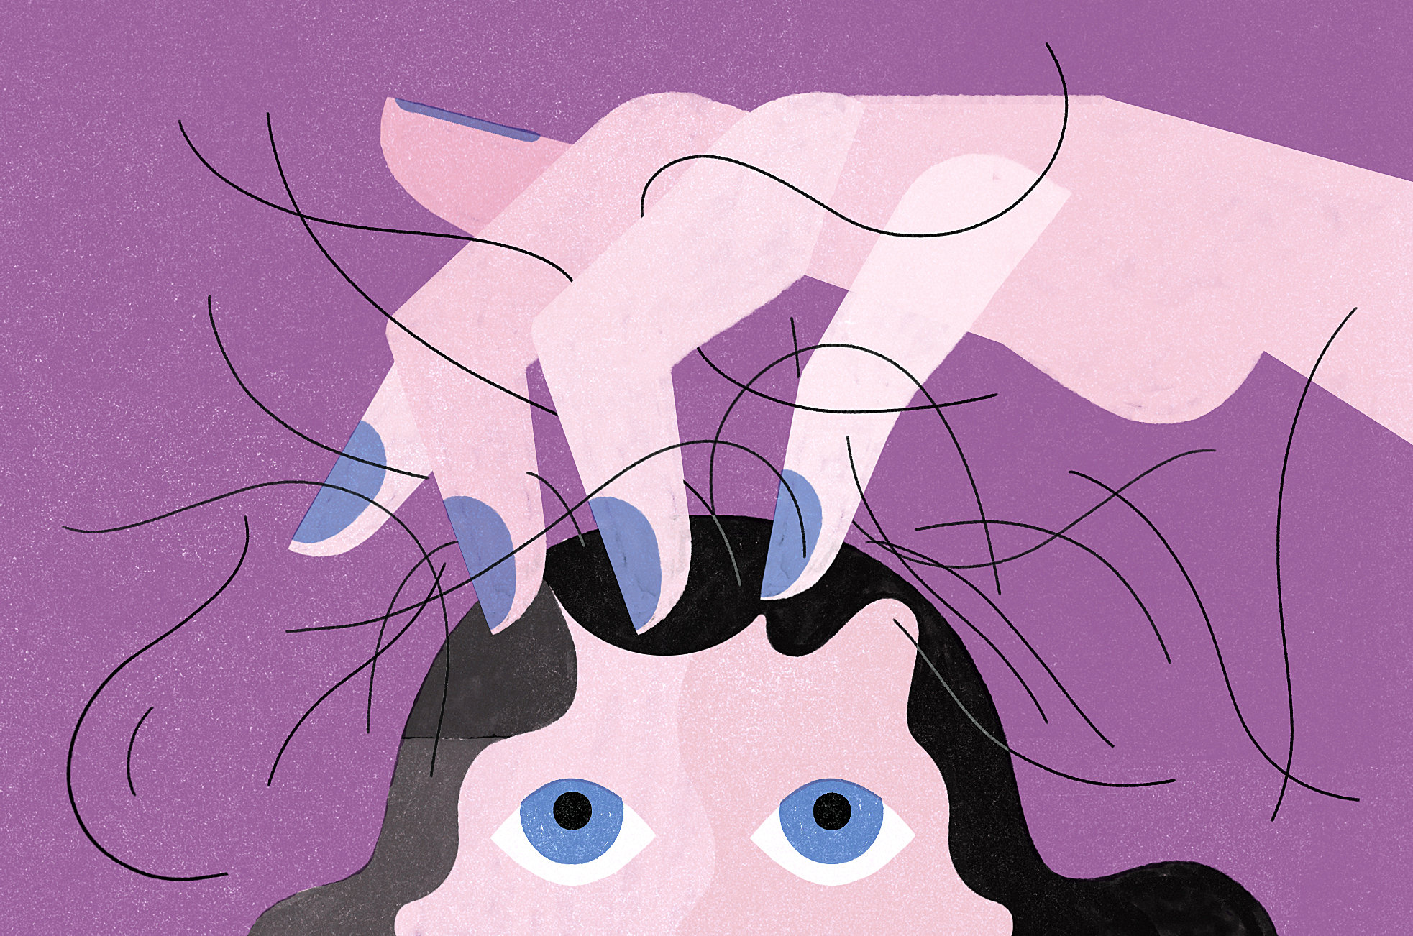
THANK YOU

